Slide 1
L10 - Verification
Initiation
All changes in the code have to be verified
  refactoring
  actualization
Essential difficulties
  programmers very often produce imperfect work
  defects are called “bugs”
Verification finds bugs
Concept Location
Impact Analysis
V
E
R
I
F
I
C
A
T
I
O
N
Prefactoring
Actualization
Postfactoring
Conclusion
© 2012 Václav Rajlich Software Engineering: The Current Practice Ch. 10

Slide 2
Verification techniques
Many techniques of software verification have been researched and proposed
Current practice
  testing
  code inspection
© 2012 Václav Rajlich Software Engineering: The Current Practice Ch. 10

Slide 3
Testing
Tests execute the program or its parts
  specific input to the execution
  compare the outputs of the execution with the previously specified outputs
  report if there is a deviation
Tests are organized into a test suite
  several, often many, tests, or test cases.
© 2012 Václav Rajlich Software Engineering: The Current Practice Ch. 10

Slide 4
Incompleteness of testing
“Testing can demonstrate the presence of bugs, but not their absence.”
No matter how much testing has been done, residual bugs may still hide in the code
  Because program state space can be too big to enumerate/test exhaustively
  But not all programs are as complicated
  Testing more effective for simpler programs
© 2012 Václav Rajlich Software Engineering: The Current Practice Ch. 10

Slide 5
New vs. old code tests
Tests of the new code
  new tests must be written with the new code
  Testing of the old code -- regression tests
  Tests detect changes that break old code
  prevent regression of what was already functioning in the software.
      Merriam Webster: “regression” = “a trend or shift toward a lower or less perfect state”
© 2012 Václav Rajlich Software Engineering: The Current Practice Ch. 10

Slide 6
Variety of software testing
Setting
  In programmer’s own workspace
  As part of team’s configuration management
Strategies
  structural
  unit
  functional
Functionality
  old (regression testing)
  new
  Combined (system testing)
© 2012 Václav Rajlich Software Engineering: The Current Practice Ch. 10

Slide 7
Acceptance tests
Final functional test
  both the new and the old functionality
Done during change conclusion phase
  test the complete functionality of the software
  software stakeholders are able to asses the progress of the software project
© 2012 Václav Rajlich Software Engineering: The Current Practice Ch. 10

Slide 8
Composition of the test suite
Unit tests
  test for a specific class
Functional tests
  test a specific functionality of the whole program
    user manual or graphics user interface guide the creation of the functional tests.
    all features available to the user should be tested
Structural tests
© 2012 Václav Rajlich Software Engineering: The Current Practice Ch. 10

Slide 9
Harness (scaffolding)
Test drivers
  implement the support for the tests
Stubs
  implement the replacement for missing classes and subsystems
Environment simulation
Harness = drivers + stubs + simulators
  production code vs. harness
  developers vs. testers
© 2012 Václav Rajlich Software Engineering: The Current Practice Ch. 10

Slide 10
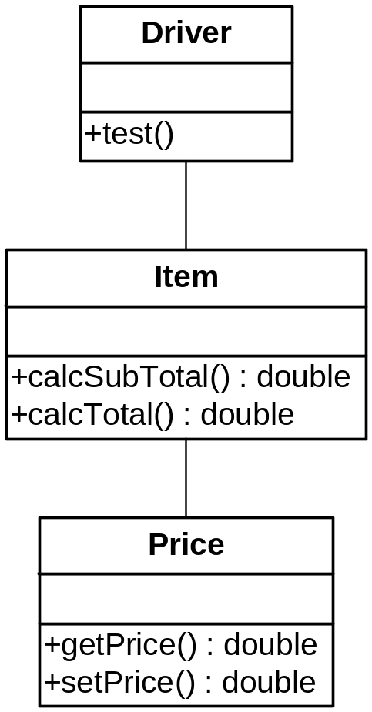
Testing driver
© 2012 Václav Rajlich Software Engineering: The Current Practice Ch. 10

Slide 11
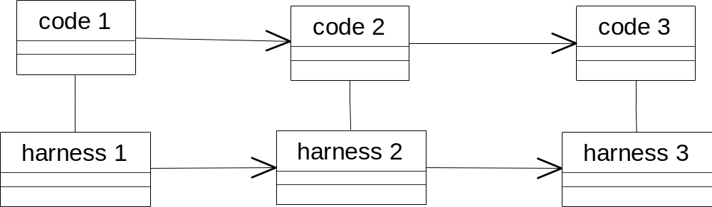
Harness and production code
Production code goes to the user
Harness stays within the programming group
Parallel evolution of both
© 2012 Václav Rajlich Software Engineering: The Current Practice Ch. 10

Slide 12
Coverage
We cannot guarantee complete correctness of the code by testing
But we aim to guarantee that each unit of the tested code is executed at least once
  this guarantees that at least some of the bugs are discovered
    in particular, the bugs that are brought up by this single execution of the unit.
© 2012 Václav Rajlich Software Engineering: The Current Practice Ch. 10

Slide 13
Granularity of methods
calcSubTotal(), calcTotal(), getPrice(), setPrice(double)
  each of them executed at least once
Seems like a crude approach
  systematic
  guarantees correctness better than random selection of tests
© 2012 Václav Rajlich Software Engineering: The Current Practice Ch. 10

Slide 14
Statement coverage
Guarantees that every statement of the program is executed at least once
Minimal test suite does not have any redundant tests
  tests that cover only statements that are already covered by other tests
Minimal test suite efficiently accomplishes the coverage
  preferred approach
© 2012 Václav Rajlich Software Engineering: The Current Practice Ch. 10

Slide 15
Example
read (x); read (y);
if x > 0 then write ("1");
else write ("2");
end if;
if y > 0 then write ("3");
else write ("4");
end if;
{<x =2, y =3>}
  incomplete coverage
  does not cover write (“2”)
{<x =2, y = 3>,<x =9,y =1>, <x =0,y =0>}
  complete coverage
  not minimal
  <x =9, y=1> is redundant
{<x =2, y= 3>, <x =0,y =0>}
  complete and minimal
© 2012 Václav Rajlich Software Engineering: The Current Practice Ch. 10

Slide 16
Minimal complete test suite
Easy to write the first test
  no matter what it covers, it adds to the test suite coverage
Increased number of tests
  the statements not covered are fewer
  it is increasingly hard to aim new tests at these remaining uncovered statements
  increased coverage may not be economic
70% coverage is considered to be good
© 2012 Václav Rajlich Software Engineering: The Current Practice Ch. 10

Slide 17
Unit testing
Testing of individual modules
  testing classes and methods
Testing of the composite functionality
  the class is being tested together with all classes that support it
Testing local functionality
© 2012 Václav Rajlich Software Engineering: The Current Practice Ch. 10

Slide 18
Testing driver
© 2012 Václav Rajlich Software Engineering: The Current Practice Ch. 10

Slide 19
Testing driver example
public class TestItem {
Item testItem;
public void testCalcSubTotal() { assert(testItem.calcSubTotal(2, 3) == 6); assert(testItem.calcSubTotal(10, 20)==200); }
public void testCalcTotal() { assert(testItem.calcTotal(0, 5) == 5); assert(testItem.calcTotal(15, 25) == 40); }
} ;
© 2012 Václav Rajlich Software Engineering: The Current Practice Ch. 10
Notes:
calcSubTotal (quantity, price): calc cost of one item on receipt
calcTotal (subtotal, tax): calc total cost of all items on receipt

Slide 20
Testing local responsibility
Driver + stub
  stub simulates suppliers
    part of harness
Reasons: supplier classes
  are not available
  have not been tested
    the confidence in them is low
  support a limited contract (limited precondition)
    the tested class to be used with other suppliers
© 2012 Václav Rajlich Software Engineering: The Current Practice Ch. 10

Slide 21
Stubbing techniques
Less effective algorithm
  easier to implement
  test becomes less efficient
    developers do testing, acceptable impact
Limited precondition of the stub
  simplifies the code of the stub substantially
    convert the date into a day of the week
      the stub does that only for a selected month
    inappropriate if the stubbing reason is to broaden the contract
© 2012 Václav Rajlich Software Engineering: The Current Practice Ch. 10

Slide 22
Stubbing techniques, cont.
User intervention
  interrupts the test, the user provides the correct answer
    practical only in if the stub is executed only few times during the test
    human user may input incorrect values
Replacement contract
  quick but incorrect postcondition
  the most controversial stubbing technique
  still may provide valuable results
© 2012 Václav Rajlich Software Engineering: The Current Practice Ch. 10

Slide 23
Functional testing
Tests the functionality of the complete program
Program with GUI: test every function
  “tape recording” for future tests
Coverage
  percentage of the requirements tested
© 2012 Václav Rajlich Software Engineering: The Current Practice Ch. 10

Slide 24
Regression Testing
After change, programmers retest the code
  reestablish the confidence that the old functionalities of the software still work
  change may have inadvertently introduced stray bugs into the intact parts
Tests from the past constitute the bulk of the regression test suite
  test suite often grows
  testing is often done overnight
© 2012 Václav Rajlich Software Engineering: The Current Practice Ch. 10

Slide 25
Code inspection
Let somebody other than the author read the code
  checks its correctness
  reports bugs
Code inspection does not require execution of a system
  can be applied to incomplete code or to other artifacts
    models, documentation
© 2012 Václav Rajlich Software Engineering: The Current Practice Ch. 10
Notes:
http://gizmodo.com/you-dont-need-to-understand-programming-to-appreciate-t-1739927472?trending_test_d&utm_expid=66866090-62.YkETBcIMTk2uX1oytHipyg.4&utm_referrer=http%3A%2F%2Fgizmodo.com%2Fyou-dont-need-to-understand-programming-to-appreciate-t-1739927472

Slide 26
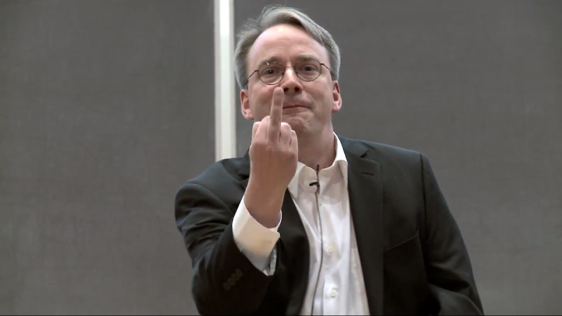
Get rid of it. And I don’t *ever* want to see that shit again.
http://gizmodo.com/you-dont-need-to-understand-programming-to-appreciate-t-1739927472?trending_test_d&utm_expid=66866090-62.YkETBcIMTk2uX1oytHipyg.4&utm_referrer=http%3A%2F%2Fgizmodo.com%2Fyou-dont-need-to-understand-programming-to-appreciate-t-1739927472
© 2012 Václav Rajlich Software Engineering: The Current Practice Ch. 10

Slide 27
Effectiveness of code inspection
“Habituation”
  people become blind to their own mistakes
After reading the code multiple times
  programmers no longer read the code
    recall from the memory what the code should contain
    some errors repeatedly escape their attention
  a different reader often spots these errors more easily and right away
© 2012 Václav Rajlich Software Engineering: The Current Practice Ch. 10

Slide 28
Inspections and testing are complementary
Some bugs are easily found by testing
  they appear in each test
    they are sometimes hard to spot by human
    example: misspellings of long identifiers
Some bugs are hard to find by testing
  it is hard to create a test that finds them
    human readers can find them easily
    example: a possible division by zero
© 2012 Václav Rajlich Software Engineering: The Current Practice Ch. 10

Slide 29
Inspection of different artifacts
Inspections can also check whether different artifacts agree with each other
  does the code correspond to the change request?
  does the UML model correspond to the actual code?
Inspections cannot check non-functional characteristics
  performance and usability
  As it does NOT run the software
© 2012 Václav Rajlich Software Engineering: The Current Practice Ch. 10

Slide 30
Walkthroughs
Structured inspection process
Walkthrough team
  at least four members
    the author of the inspected code
    a moderator
    at least two code reviewers.
© 2012 Václav Rajlich Software Engineering: The Current Practice Ch. 10

Slide 31
Walkthrough process
Preparation
  the code or other work products are distributed to inspection team
  one participant (reader) is selected to inspect the document thoroughly
Walkthrough meeting
  all team members participate
  whole group walks through the document under direction of the reader
© 2012 Václav Rajlich Software Engineering: The Current Practice Ch. 10

Slide 32
Walkthrough meeting
The reader notes the errors, omissions and inconsistencies in the code
  the other members of the team add their own observations
The moderator chairs the meeting
  notes the discovered errors
  produces a report
    recommendations, which documents have to be corrected or reworked
© 2012 Václav Rajlich Software Engineering: The Current Practice Ch. 10

Slide 33
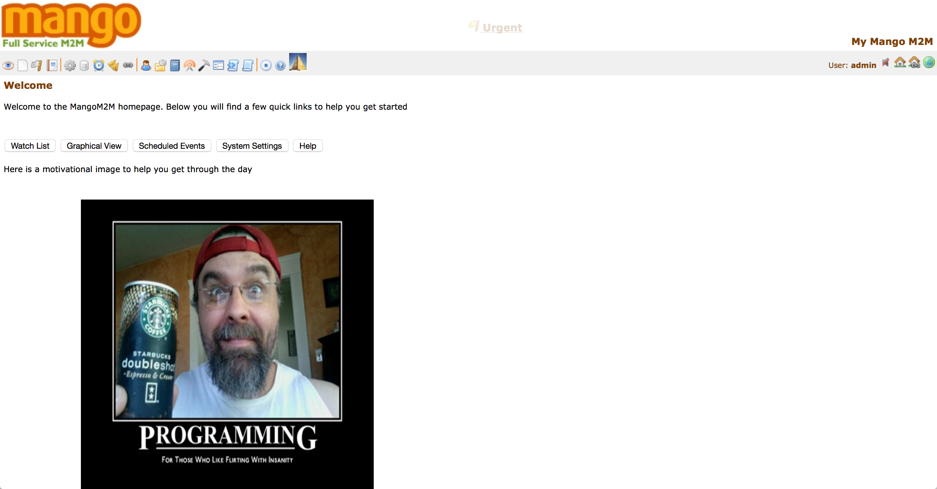
Update Project Deliverables
Briefly summarize process, #hour taken
Briefly explain why a change is needed (what it accomplishes)
Proof read before submitting
© 2012 Václav Rajlich Software Engineering: The Current Practice Ch. 10

